Slide 1
Mapping URLs with Params

Slide 2

urls.py

Slide 3
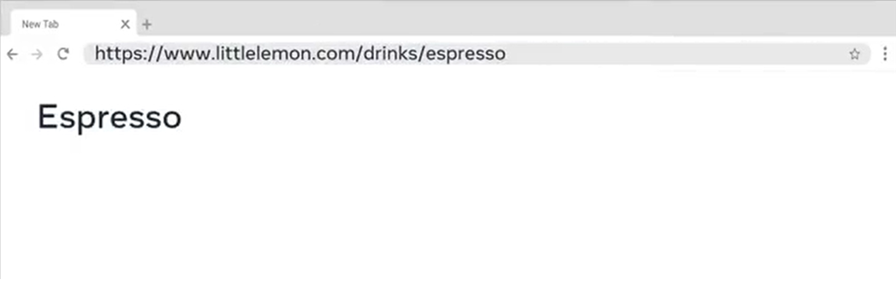

Slide 4


Slide 5

urls.py

Slide 6
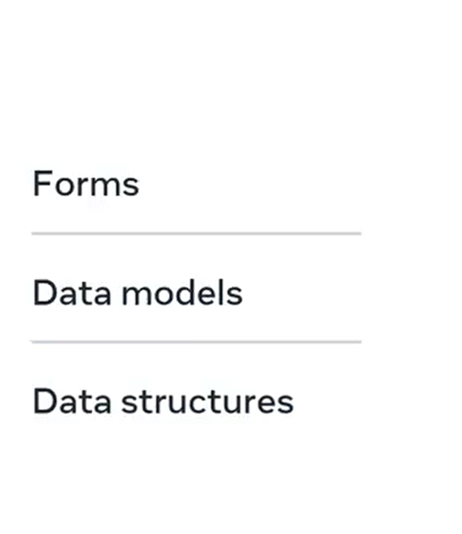

Slide 7
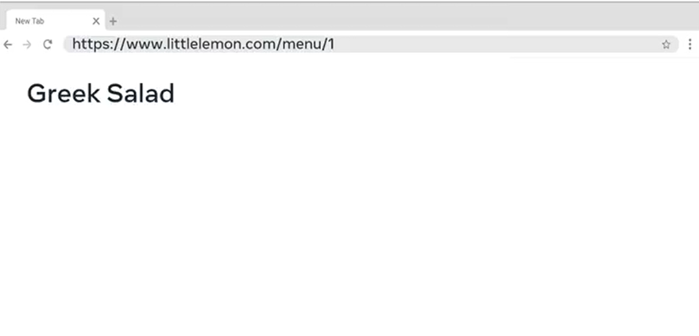

Slide 8


